Slide 1


Modelling and Exploration of Coarse-Grained Reconfigurable Arrays: Using the
Open-Source CGRA-ME Framework
Omar Ragheb, Stephen Wicklund,
Kentaro Sano¹, Jason Anderson
DATE’24 Tutorial, Valencia, Spain
March 26, 2024

Slide 2
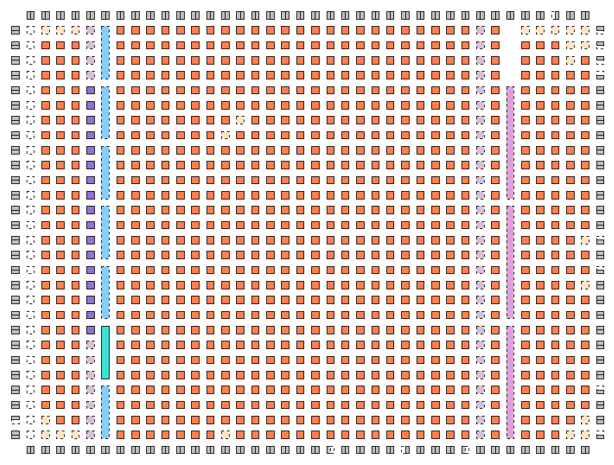
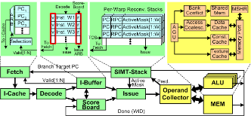

CGRA Challenges
Architectures less studied than competing platforms,
such as FPGAs or GPGPUs
CAD tool development required
CGRAs: ???
GPUs:
GPGPU-Sim
FPGAs:
Verilog-to-Routing
Processors: gem5
Notes:
- why cgra

Slide 3
Introduction to CGRA-ME
CGRA-ME: an open-source modelling and exploration framework for CGRA architecture and CAD exploration
Objectives:
  Allow an architect to model a wide range of CGRA architectures via a C++ API
  Allow an application, described in a high-level language, to be mapped onto the modelled CGRA
  Area, performance, and power modelling of the CGRA for an application
This allows for:
  Simulation and verification of application on modelled CGRA
  Physical realization of CGRA as an ASIC or FPGA overlay

Slide 4
CGRA-ME: Framework
Benchmark
CGRA Architecture Description
Architecture Constraints
CGRA Architecture Interpreter
LLVM
Data-Flow Graph of Application
Device Model of Architecture
Verilog RTL for CGRA
Mapper
Verilog Simulation
Std. Cell Synthesis Place and Route
FPGA Synthesis Place and Route
Bitstream
Functional Verification
Standard-Cell CGRA Perf, Power & Area
FPGA-Overlay CGRA Perf, Power & Area
Notes:
Xander starts here

Slide 5
CGRA-ME: Inputs
Benchmark
Architecture Constraints
CGRA Architecture Description
CGRA-ME Framework takes in three input files which are:
Benchmark:
  C code application that needs acceleration
  Example benchmarks are machine learning, signal processing, image processing, …
Architecture Constraints:
  A constraint file that specifies the routing constraints and the fixed ports.
Architecture description:
  A C++ description of an CGRA architecture
  (specified using CGRA-ME’s API)
Notes:
Xander starts here

Slide 6
CGRA-ME: Architecture Description
Benchmark
CGRA Architecture Description
Architecture Constraints
CGRA Architecture Interpreter
LLVM
Data-Flow Graph of Application
Device Model of Architecture
Verilog RTL for CGRA
Mapper
Verilog Simulation
Std. Cell Synthesis Place and Route
FPGA Synthesis Place and Route
Bitstream
Functional Verification
Standard-Cell CGRA Perf, Power & Area
FPGA-Overlay CGRA Perf, Power & Area
Notes:
Xander starts here

Slide 7
Architecture Description
As a user of CGRA-ME, there are two aspects of architecture that you need to describe
The first is the content of the Processing Element (PE)
The second is the PE matrix and the interconnect connecting the constituent PEs.

Slide 8


RIKEN PE – Instantiate Submodules
MUX A
buff A
Join
FP Wrapper
buff Out
Crossbar (SB)
IMM
fork
buff B
MUX B
addSubModule(new ElasticBufferFIFO(“buff_A", loc, buffer_depth, 32));
addSubModule(new ElasticBufferFIFO(“buff_b", loc, buffer_depth, 32));
addSubModule(new Multiplexer(“MUX_A", loc, num_inputs + 2));
addSubModule(new Multiplexer(“MUX_B", loc, num_inputs + 2));
addSubModule(new ConstUnit(“IMM", loc, 32));
addSubModule(new ElasticFPFuncUnit(“FPALU", loc, Op-list, 32, latency));

Slide 9
RIKEN PE – Interconnect Modelling
MUX A
buff A
Join
FP Wrapper
buff Out
Crossbar (SB)
IMM
fork
buff B
MUX B
connectPorts(“crossbar.out” + num_outports - 1, “buff_A.in”, isElastic);
connectPorts(“crossbar.out” + num_outports, “buff_B.in”, isElastic);
connectPorts(“buff_A.out”, “MUX_A.in0”, isElastic);
connectPorts(“buff_B.out”, “MUX_B.in0”, isElastic);
connectPorts(“MUX_A.out”, “join.in0”, isElastic);
connectPorts(“MUX_B.out”, “join.in1”, isElastic);

Slide 10
RIKEN PE – Add Configuration Bits
MUX A
buff A
Join
FP Wrapper
buff Out
Crossbar (SB)
IMM
fork
buff B
MUX B
addConfig(“MUXAConfig”, {“MUX_A.select”}, isElastic);
addConfig(“MUXBConfig”, {“MUX_B.select”}, isElastic);
addConfig(“IMMForkConfig”, {“Imm_fork.enable_downstream”}, isElastic);
addConfig(“IMMConfig”, {“Imm.in”}, isElastic);
addConfig(“FPALUConfig”, {“FPALU.select”}, isElastic);

Slide 11
Main C++ Function Calls
Instantiating submodules
addSubModule(new $(Module Class)($(Name), $(location), $(other args)));
Connecting ports
connectPorts($(Source Port Name), $(Sink Port Name), $(elastic bool));
Adding configuration bits
addConfig($(Config Name), $(Config Port Name), $(elastic bool));

Slide 12
CGRA – Instantiate PE Matrix
for (unsigned int c = 0; c < cols; c++) {
for (unsigned int r = 0; r < rows; r++) {
addSubModule(new ProcessingElement(“PE_“ + r + c));
}
}

Slide 13
CGRA – Instantiate PE Matrix
IO Port
Mem Port
IO Port
Mem Port
IO Port
Mem Port
IO Port
Mem Port
Next steps for a full architecture model:
  Interconnect the PE Matrix
  Add IO ports
  Add Memory Ports

Slide 14
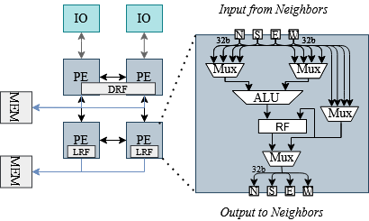
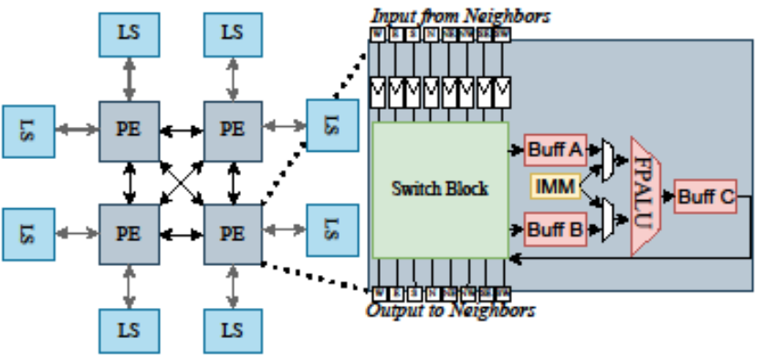
CGRAs Modelled within CGRA-ME
There are three main CGRAs modelled within CGRA-ME 2.0 release
  ADRES
  HyCUBE
  RIKEN
ADRES
Elastic RIKEN

Slide 15
Architecture Modelling Summary
CGRA-ME provides a C++ API that allows one to:
  Instantiate a variety of primitives
    ALUs, Constants, Buffers, Registers, …
  Connect primitives to one another:
    Crossbars, Direct connections, MUXes, …
  Add configurability for the interconnect/primitives
With API, one can model wide range of different CGRAs
Limitations/ongoing work:
  Modelling predication, mixed bitwidth CGRAs and etc.

Slide 16
CGRA-ME: DFG generation
Benchmark
CGRA Architecture Description
Architecture Constraints
CGRA Architecture Interpreter
LLVM
Data-Flow Graph of Application
Device Model of Architecture
Verilog RTL for CGRA
Mapper
Verilog Simulation
Std. Cell Synthesis Place and Route
FPGA Synthesis Place and Route
Bitstream
Functional Verification
Standard-Cell CGRA Perf, Power & Area
FPGA-Overlay CGRA Perf, Power & Area
Notes:
Xander starts here

Slide 17
DFG Extraction CGRA-ME
Front-end data-flow graph extraction -- LLVM
  State-of-the-art compiler used by Apple, NVIDIA, Xilinx, Intel, etc
  Leverage LLVM language support, parsing and optimizations
In LLVM, the program is represented in an
Intermediate Representation (IR)
  Machine-independent assembly code
  Limited instruction set:
  add, xor, branch, mul, div
Target inner-loop kernels for mapping to CGRAs

Slide 18
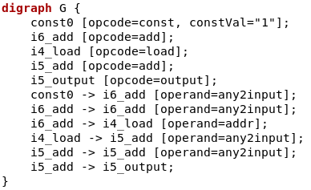

Data-Flow Graph Extraction
//DFGLoop: loop : marks the loop to be extracted

Slide 19
Data-Flow Graph Visualization
DFG is a directed graph made up of:
  Nodes N
Const0
i6_add
i4_load
i5_add
i5_output

Slide 20
Data-Flow Graph Visualization
DFG is a directed graph made up of:
  Nodes N
  Edges E
Const0
i6_add
i4_load
i5_add
i5_output

Slide 21
CGRA-ME: Device Model Graph
Benchmark
CGRA Architecture Description
Architecture Constraints
CGRA Architecture Interpreter
LLVM
Data-Flow Graph of Application
Device Model of Architecture
Verilog RTL for CGRA
Mapper
Verilog Simulation
Std. Cell Synthesis Place and Route
FPGA Synthesis Place and Route
Bitstream
Functional Verification
Standard-Cell CGRA Perf, Power & Area
FPGA-Overlay CGRA Perf, Power & Area
Notes:
Xander starts here

Slide 22
Device Model Graph: Nodes
Each node is in one of three types.
Functional node
  Represent units that execute instructions such as
  add, mul, PHI
Routing node
  Nodes that create links between different functional or memory nodes
Memory node
  Nodes that can store data for 1 or more clock cycles

Slide 23
Device Model Graph: Modulo Routing Resource Graph (MRRG)
Generalizable – handles multiple types of primitives
Piecemeal construction
Registers are handled differently
FU
REG
From previous clock cycle
To next clock cycle
Example Block
Notes:
Piecemeal construction – done one at a time over time

Slide 24
LLVM IR-based Functional Units
We align the functionality specification of CGRA blocks with the LLVM IR computational instructions
The capabilities of the architecture are expressed in the same instruction set as the compiler to the architecture
Example Block
mul | add | mul->add
FU
REG

Slide 25
CGRA-ME: Mapping
Benchmark
CGRA Architecture Description
Architecture Constraints
CGRA Architecture Interpreter
LLVM
Data-Flow Graph of Application
Device Model of Architecture
Verilog RTL for CGRA
Mapper
Verilog Simulation
Std. Cell Synthesis Place and Route
FPGA Synthesis Place and Route
Bitstream
Functional Verification
Standard-Cell CGRA Perf, Power & Area
FPGA-Overlay CGRA Perf, Power & Area
Notes:
Xander starts here

Slide 26
What is Mapping?
Mapping is finding the subset of the MRRG that the DFG can be embedded into.
The complexity of the mapping problem stems from aspects of both the application and the architecture:
  Long pipelines
  Limited interconnect in the architecture
Mapping is an interesting area of research, and within CGRA-ME 2.0, there are three main mappers:
  ILPMapper DAC’18
  Heuristic Mapper FCCM’19
  Clustered Mapper DAC’24

Slide 27
CGRA-ME: Verification and Profiling
Benchmark
CGRA Architecture Description
Architecture Constraints
CGRA Architecture Interpreter
LLVM
Data-Flow Graph of Application
Device Model of Architecture
Verilog RTL for CGRA
Mapper
Verilog Simulation
Std. Cell Synthesis Place and Route
FPGA Synthesis Place and Route
Bitstream
Functional Verification
Standard-Cell CGRA Perf, Power & Area
FPGA-Overlay CGRA Perf, Power & Area
Notes:
Xander starts here

Slide 28
Verilog Generation (1)
Generate RTL for:
  Simulation / Verification
  Standard cell (ASIC) synthesis, placement and routing
  FPGA-overlay synthesis, placement and routing

Slide 29
Verilog Generation (2)
CGRA
IO
IO
IO
Take the module tree that the MRRG was generated from, and emit a parameterized Verilog file for each module type:
  Includes ports, sub-module declarations, and a generic implementation of the block.
Modules for configuration are also added to the parent module of their configuration target
  Automatically connected to the right module, and linked together to form an inter-module scan chain.
FU
FU
FU
FU
FU
FU
FU
FU
FU
io
io
Func. U.
Func. U.
C
C
ALU
ALU
Func. U.
C
C
ALU
ALU

Slide 30
Configuration Bitstream Generation
A successful mapping associates all nodes and edges in the DFG with one or more MRRG nodes.
Iterate the mapped sub-modules, generate a configuration bitstream for the submodule of the application.
+
FU
REG
DFG
MRRG
Modules

Slide 31
Functional Verification
Configuration bitstream is emitted as part of a “configurator” Verilog module
Testbench instantiates configurator & CGRA,
provides clock signal, etc.
Permits functional verification of the CGRA as configured for an application
CGRA-ME
Testbench
benchmark.c
Configuration Gen.
configurator.v
ModelSim
Verilog Gen.
CGRA.v

Slide 32
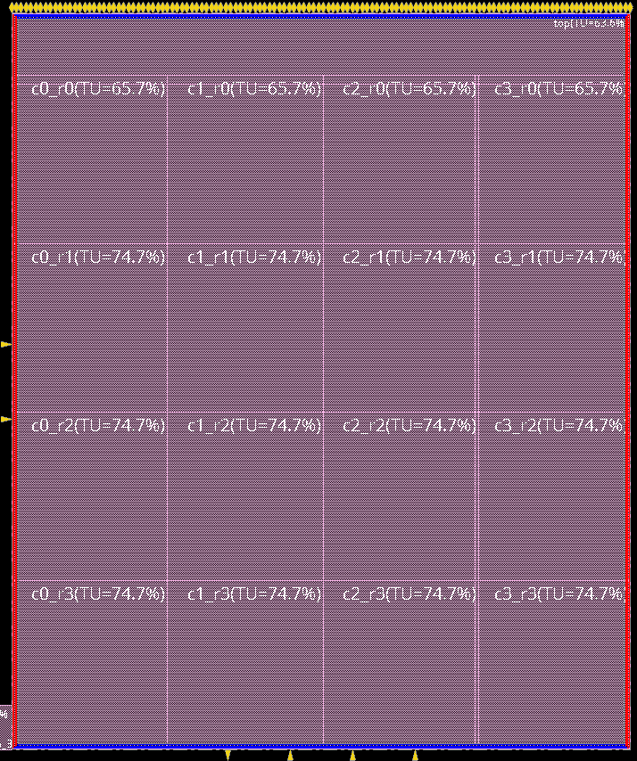
Standard Cell CGRAs
Input CGRA Verilog RTL into ASIC flow
  Open source 45nm standard cell library
  Implementation is not optimal, but allows relative comparisons between architectures
Synthesized with Synopsys Design Compiler
Place and route with Cadence Innovus (floorplanned)
STA performed using Synopsys Prime Time
Floorplanned 4x4 ADRES CGRA
in standard cells

Slide 33
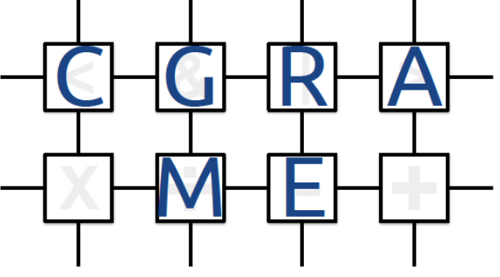
Thank You for Joining Us! https://cgra-me.ece.utoronto.ca/

